Slide 1








Lesson 1. Angular4 Components

Slide 2
What is a Component in Angular 4
A component in Angular is a class with a template and a decorator
Template
Class
Decorator
Template defines the user interface. Contains the HTML, directives and data bindings
Class contains the code required for the template
Decorator adds meta data to the class making it an Angular Component

Slide 3
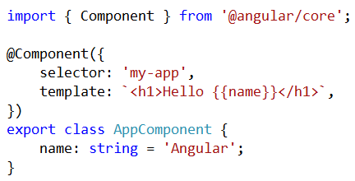
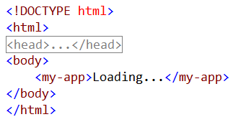
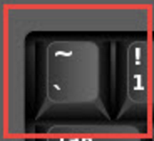
Angular 4 Components
app.component.ts
Index.html
This is a BACKTICK not a SINGLE QUOTE

Slide 4
Q & A
Contact:rashmipawaskar@synergetics-india.com

Slide 5
Thank You

